Slide 1
PRBot - Exploring AI Summarization Outputs for Issues, PRs and Repos
Don Syme – my opinions but based on work of all of GitHub Next

Slide 2
AI Outputs Overview
Summarization
Chat
Generative
Critique
Indexing

Slide 3
AI Outputs Overview
Summarization
Keywords
Title
Summary
Abstract
Walkthrough
Chat
Generative
Critique
Indexing

Slide 4
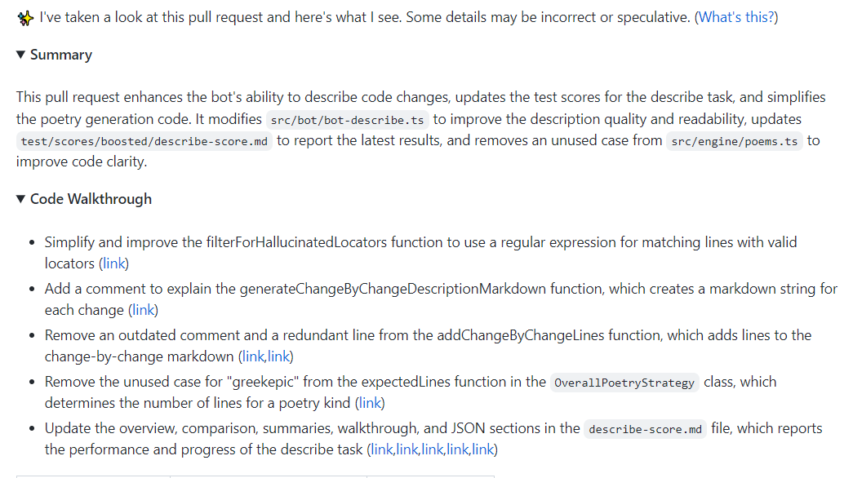
AI Summarization – Example – PR Summary
./prbot describe https://github.com/githubnext/prbot/pull/565

Slide 5
AI Summarization – Example – PR Walkthrough
./prbot describe https://github.com/githubnext/prbot/pull/565
Note: Grouping is implemented here, no titles for groups (no “sections”)
Note: Small Inaccuracies are common. May be possible to remove ~90% of these over time but some will remain.

Slide 6
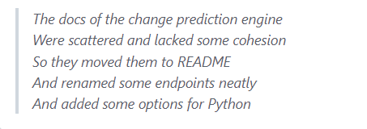
AI Summarization – Example – PR Poem
./prbot describe https://github.com/githubnext/prbot/pull/565
Note: humorous but seems well-received, good for team cohesion

Slide 7
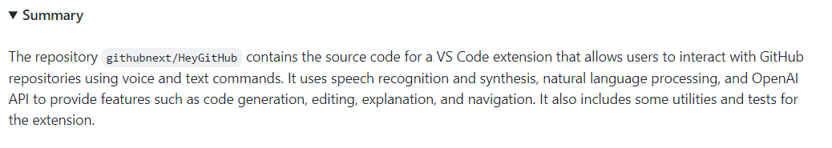
AI Summarization – Example – Repo Summary
./prbot summarize https://github.com/githubnext/HeyGitHub --include "src/*/*.ts"

Slide 8
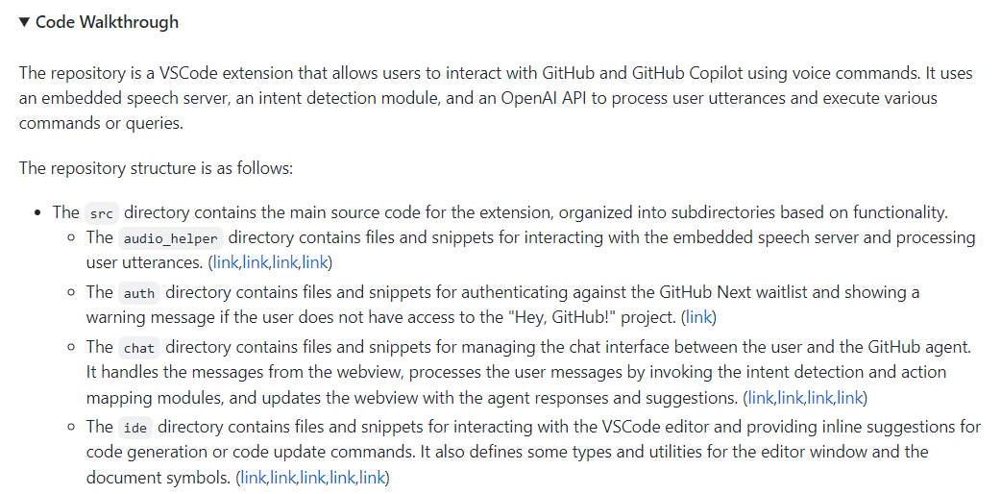
AI Summarization – Example – Repo Walkthrough
./prbot summarize https://github.com/githubnext/HeyGitHub --include "src/*/*.ts”

Slide 9
The Principles
Utility
Quality
Handling Change
Trust
User Promotion

Slide 10
The Principles
Utility
The AI outputs must make some human task faster, or better
All new outputs take user attention. They aren’t free.
Quality
The AI makes mistakes, the user must either approve/reject or tolerate or not care
Users seem more tolerant of mistakes in ephemeral outputs
The longer the AI outputs, the greater the chance of mistakes
Change
AI outputs should be fresh and up-to-date
User-editing of outputs is often requested, but beware it’s a quagmire in a changing context
Trust
Authorship must be understood - the user must understand that they are reading AI outputs
A human must explicitly take ownership after checking
User Promotion
AI outputs should be labelled until explicitly promoted (= integrated(edited) or accepted or ticked or reported) by user.
In editing contexts this is best done via ghost suggestions, in non-editing contexts this is harder
There is a spectrum of promotion UX possible. User editing of outputs is at one end. Mark as misleading is at the other.
The longer and more permanent the AI outputs, the more chance the user will want to edit them

Slide 11
AI Summarization - Techniques
Techniques:
Process all inputs, chunk by chunk, snippet by snippet, file by file etc.
Combine summaries hierarchically
Divide-and-conquer outputs to stay within prompt limits
Attempt to give appropriate context
Operate within a budget
Make it all incremental

Slide 12
AI Summarization – Example – PR Walkthrough
./prbot describe https://github.com/githubnext/prbot/pull/565
Note: Grouping is implemented here, no titles for groups (no “sections”)
Note: Small Inaccuracies are common. May be possible to remove ~90% of these over time but some will remain.

Slide 13
AI Summarization Latencies
Using latest models
Any PR/Issue discussion summarization:
~15sec?
Any PR Summarization:
~2 Minutes?
Any Repo Summarization:
10+ Minutes if from scratch?

Slide 14
Testing (PR summarization)
200 PRs, fairly randomly chosen, range of sizes
Capture baselines, allow precise reply
Score changes
Flesch
ROUGE (precision, recall), BLEU v. Human summary in PR
Adhoc statistics (length, grouping)
Eyeball stats and differences to shape outputs based on user feedback

Slide 15
Some Lessons
Quality is critical – users notice all mistakes
Utility is subtle – many different participants in a PR
Size matters – large AI outputs are hard
Change matters – freshness is critical, but users also want control
Trust matters – label all outputs!
Shaping the outputs reliably is hard but possible
Successful UX is hard
Ghost text is amazing: small, non-intrusive, generative AI outputs in a changing context with never-ending user review
Immutable “AI Opinion” seems plausible for small summarization outputs
Struggling with large summarization outputs, with too many mistakes

